Slide 1
Coding Basics and Importing Data
Patrick Mathias
Lesson 2
DLMP Core

Slide 2
Lesson Goals
Learn some fundamental of coding
Lesson Objectives
Define and use functions
Define and create objects in the environment
Install and load packages
Import data into R
Interact with a dataframe
Notes:
In the second session we will learn some fundamentals of coding including using functions, creating objects, and importing data.

Slide 3
The Basics of Coding

Slide 4
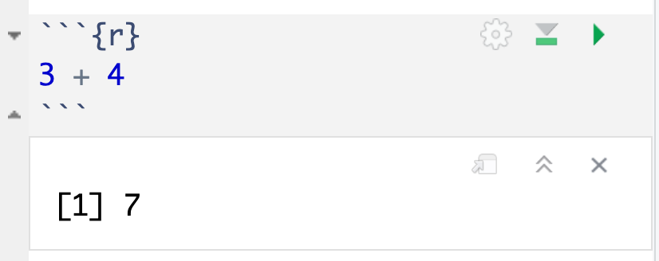
The Basics of Coding: Calculation
press play button to execute code
R is a calculator!
answer returned below
Notes:
At it’s most basic, R is a fancy calculator.
It supports common mathematical operators
+ add, - subtract
* multiply, / divide
^ exponents
When we execute our code by pressing the play button, the answer is returned below the code chunk.

Slide 5
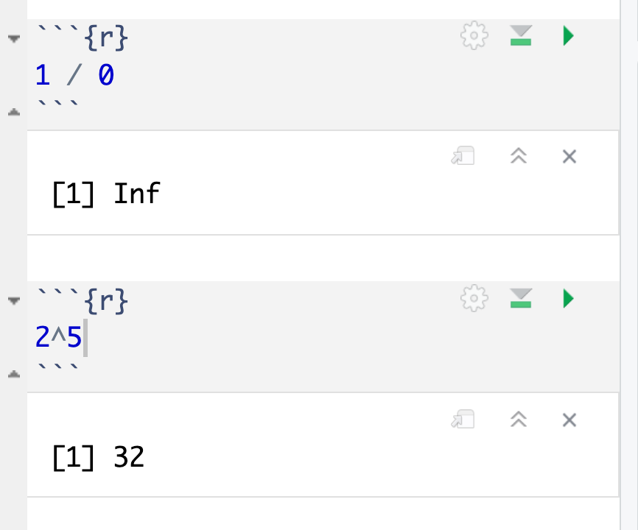
Common arithmetic operations

Slide 6
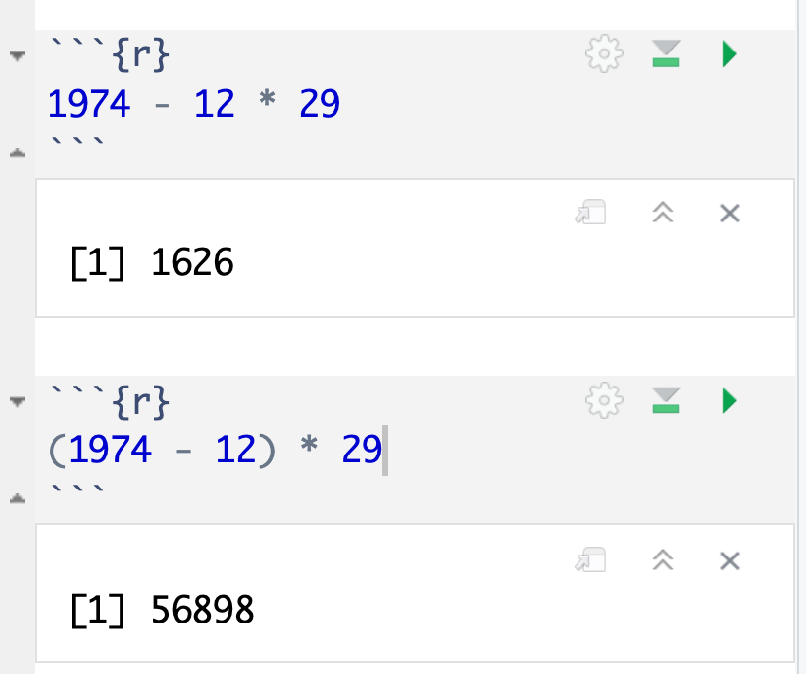
Don’t forget those math rules

Slide 7
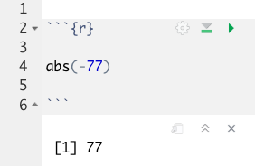
The Basics of Coding: Functions
Code that extends our reach beyond the basic operators
function
(does stuff)
argument
(input)
abs(-77 )
Notes:
Functions are code that perform actions on our behalf. We can use functions that others have written (or that we write ourselves) to reuse existing code over and over.
Functions accept an argument (input). We use parentheses as the syntax (grammar) to identify the argument(s).
Then the function does its task and provides us with some output, in this case the absolute value of an integer.

Slide 8
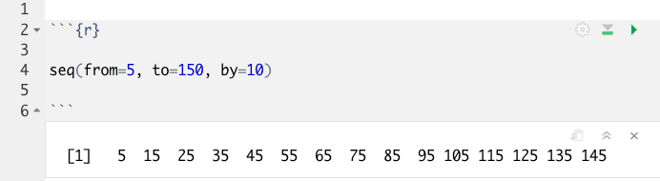
Putting Functions to Work
We can use functions to do more than simple math, we can make things!
We can create a series of integers (a vector) using the seq() function
Notes:
Functions can do more than simple math.
In this case the sequence function seq() accepts arguments defining a start position, a stop position, and an interval, to create a series (a vector) of integers.

Slide 9
The Basics of Coding: Objects
Objects are the container for your output
object
(stores output)
function
(does stuff)
arguments
(input)
sequence_of_10s <- seq(from=5, to=150, by=10 )
Notes:
Objects are a very important concept in many programming language.
Objects are the containers in which we can store things for later use.
You can store single values, series, tables, or even text.
In this example we are taking our previous seq() created series and storing it out to an object which we have called sequence_of_10s.
The <- characters are called an assignment operator. They point to the place where we want to store output.
You can execute code without assigning it to an object however the output is not stored for future use. If you want to revisit or reference the output of a particular line of code, assign it to an object using the assignment operator <-

Slide 10
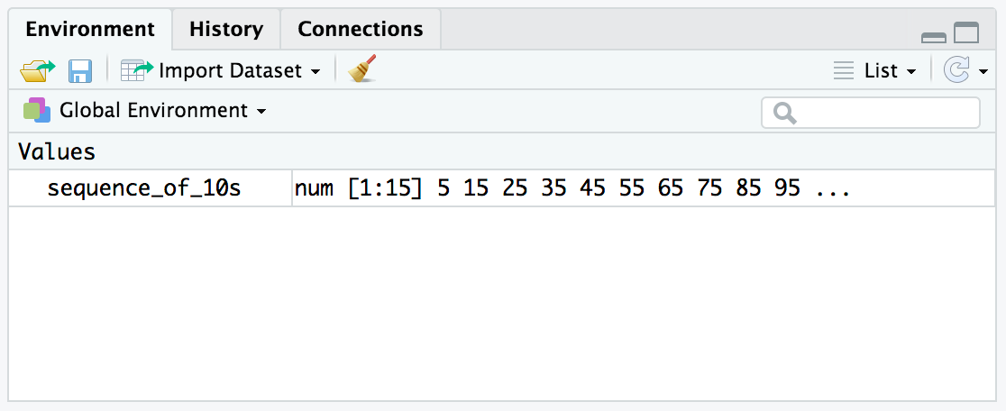
Checking the contents of an object
The environment tab shows us the objects we have created.
Notes:
We can also review our object in RStudio via the environment tab.
When we create an object in the environment, it will appear in the environment tab and we can review its contents there.

Slide 11
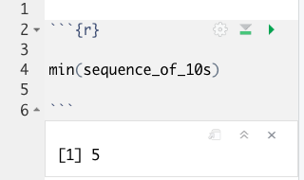
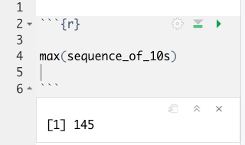
Bending objects to your will
Once we have created an object we can start to interact with it.
This includes passing our objects to other functions… Whoa!
Notes:
Objects are subject to same laws of programming we have learned so far.
We can provides objects as arguments for functions.

Slide 12
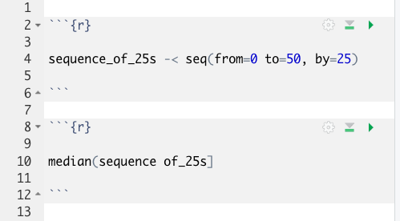
Your Turn #1
I’ve written some code to create a sequence from 0 to 500 in increments of 25 called sequence_of_25s. Ultimately I want to calculate the median value of this sequence. Unfortunately I’ve made some mistakes in my code and I am hoping you can help me find them.
Notes:
We will meet back together in a minute to see if we can fix this code together.
Hint: There are a total of 5 mistakes.

Slide 13
Common functions: combine values into a vector
object
(stores output)
function
(does stuff)
arguments
(input)
short_vector <- c(1, 2, 3, 4, 5)
Create an object called short_vector and store a vector containing 1 through 5
Think of this vector as a column of numbers you can apply functions/perform calculations on

Slide 14
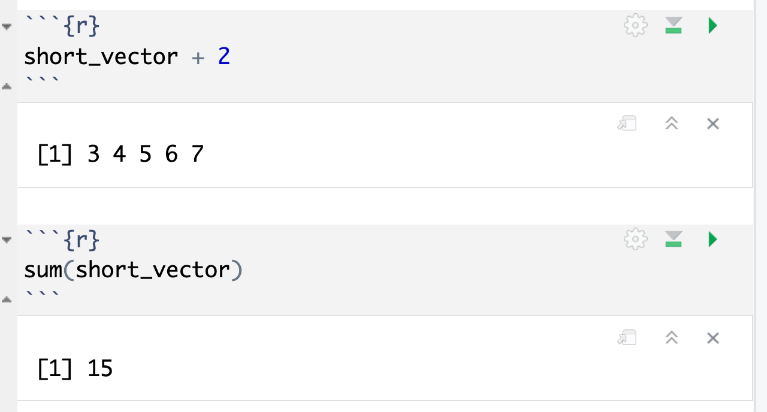
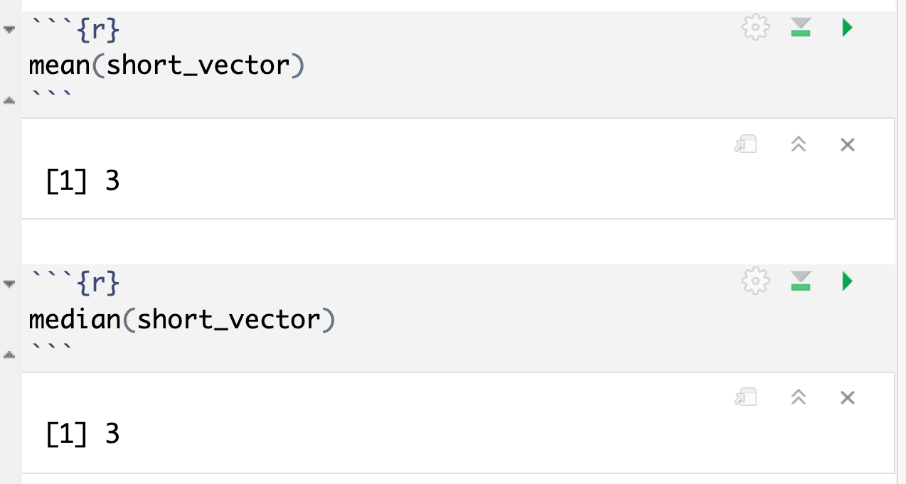
Common functions: simple statistics

Slide 15
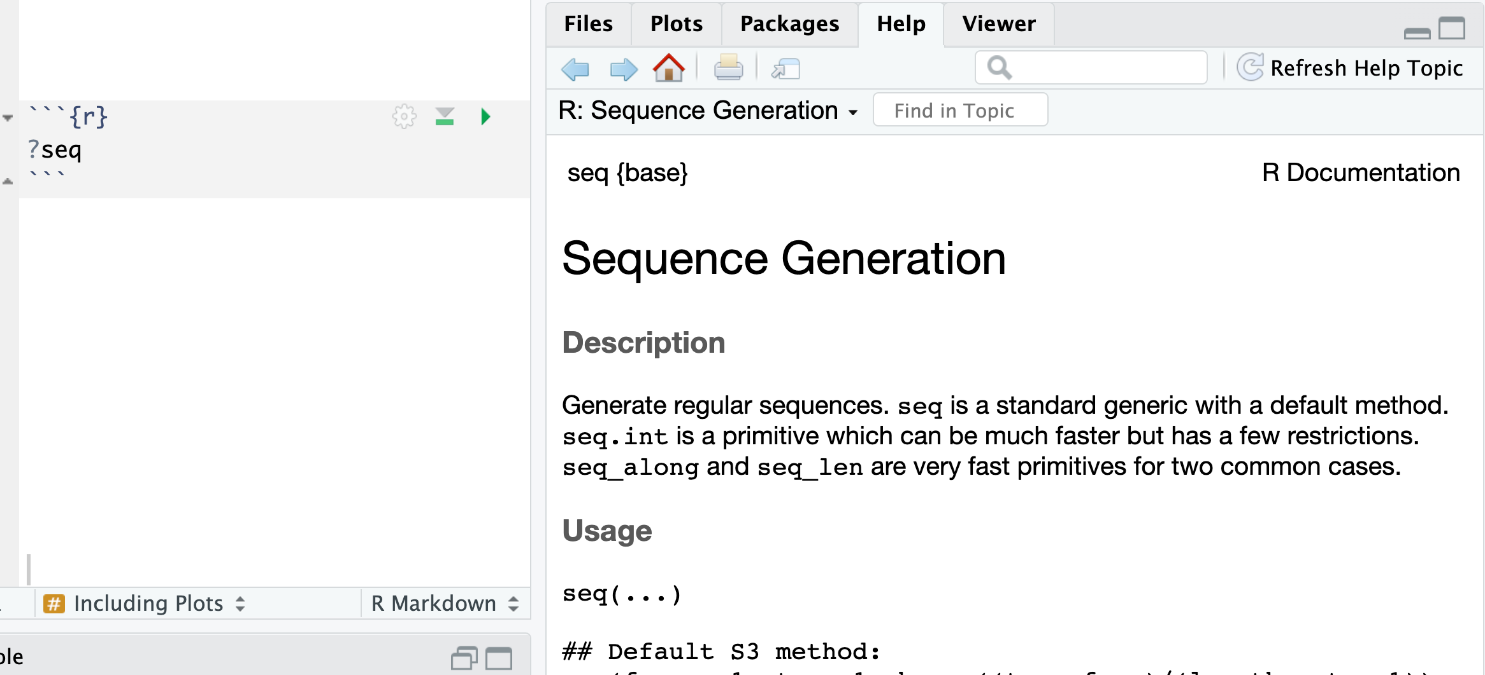
How do I find out more about functions?
Work Aids (RStudio Cheat Sheets: https://www.rstudio.com/resources/cheatsheets/)
A Good Book (R for Data Science: http://r4ds.had.co.nz/)
The Internet (Stack Overflow: https://stackoverflow.com/)
Notes:
Sometimes you will need more help than the R help feature provides.
There are many wonderful freely available resources on the internet to assist you.
Chances are others have tackled similar challenges. A quick internet or forum search can often provide an answer.
The folks at RStudio have developed a number of cheat sheets which are great references. Many of us keep printed copies of these near our desks for the features and tools we use most.
Also, there are a number of great reference books out there. One of our favorites is R for Data Science. It is freely available online and print copies are available also.

Slide 16
Importing Data
Notes:
Now that we are familiar with how to create R Markdown documents we can begin the process of performing data analysis in R in earnest by importing a clinical data set.

Slide 17
The Data Analysis Pipeline
From R for Data Science (https://r4ds.had.co.nz/introduction.html)
Notes:
This diagram may look familiar, you saw it in the Welcome presentation.
The first step in the data analysis pipeline is to load the data into the environment so we can begin to tidy and transform that data.
In today’s course we will be using a de-identified data set consisting of COVID-19 laboratory test results from a microbiology lab. This data is stored as a CSV file.

Slide 18

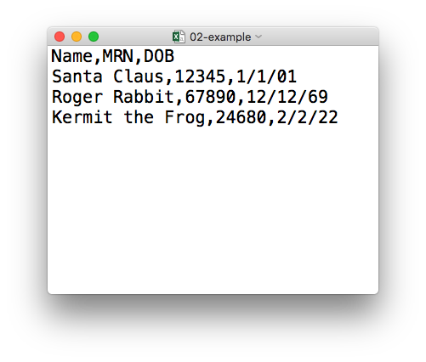
plain text (“flat”) file
csv
rectangular structure
header row
Notes:
So what’s a CSV file? CSV stands for comma-separated values.
** A CSV file is a plain text file, which means you can open it in a text editor and look at it.
Here we have a CSV file with the names, medical record numbers, and dates of birth for three fictional “patients”
** This data structure is called rectangular because it falls into rows and columns, where each row has the same # of columns, and each columns has the same # of rows.
** Also note that this particular CSV file has a header row that instead of data, has a descriptor of what kinds of data are found in each column. CSV files often but not always have such a header row.

Slide 19
Tidyverse: R Packages for Data Science
A consistent way to organize data
Human readable, concise, consistent code
Build pipelines from atomic data analysis steps
Notes:
To import our CSV data, we need some additional data analysis tools. In this course, we will be leveraging the Tidyverse.
The Tidyverse is a modern set of tools for data analysis in R. It’s quickly becoming the de facto standard for doing data science with R.
The basic tenets of “tidy” data analysis include:
Data should be organized in a consistent, standardized way. Each row is an observation, and each column is a variable. This is a very common way to organize data in a spreadsheet and might sound familiar from how you may already organize data in tools like Excel.
Programming code that acts on the data should be consistent, concise, and mimic the narrative language as much as possible.
Each data analysis can be broken down into a series of atomic steps, such as “select this column” or ”arrange the data by the values in that column”. An arbitrarily complex data analysis can be broken down as a pipeline of atomic steps.

Slide 20
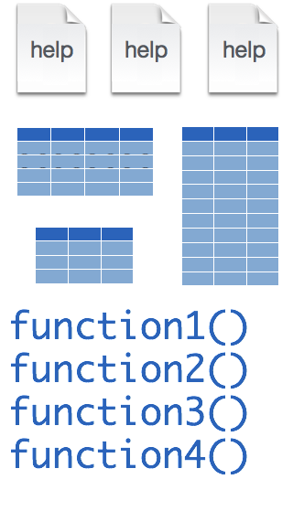
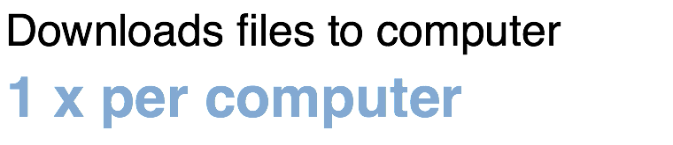
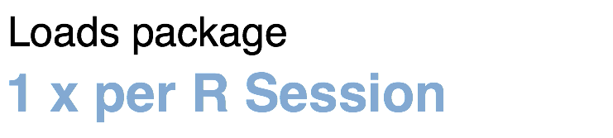
Installing and loading R packages
tidyverse
install.packages("tidyverse")
library("tidyverse")
Notes:
The Tidyverse is package (a collection of functions, data, and help documentation) that we can use to extend the functionality of R.
Packages need to be installed explicitly – with the command install.packages. So let’s say you want to install a package named “tidyverse”. You go to the R Console and type install.packages(“tidyverse”).
Each package you want to use needs to be installed only once on each computer. However, in order to use the functions or data in the package, you also need to load the package. This is done with the command “library”. So to enable all the functions in the “tidyverse” package, you type library(“tidyverse”). Packages remain loaded until you quit R. So every time you start a new R session you have to load each package that you want to use again.
On our RStudio Server, you won’t need to install any packages for this course (we have installed them for you). But at times in this course you’ll need to load packages.
So these are the first two R commands we’ve covered - install.packages and library.

Slide 21
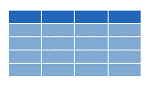

Dataframes: Beyond the Vector
Dataframe is the term for a table
Dataframes are composed:
Columns (Variables)
Rows (Observations)
Dataframes are objects and can be acted on like other objects
csv
xls
db
Notes:
Dataframe is the term we use for a table (think Excel spreadsheet).
Dataframes consists of columns (variables) and rows (observations). This is the tidy way to organize our data.
We can store dataframes as objects and perform actions on them like other objects.
We can get data into R from a variety of file formats (comma separated value files, excel spreadsheets, or directly from databases). This is the import part of data analysis.

Slide 22

read_csv()
data_frame <- read_csv(file_name)
csv
Notes:
Once, the Tidyverse package has been loaded via library, we can import CSV files using the read_csv() function.
Here is a template for how to use the read_csv function to create a data frame object from a CSV file.
You start with the name of a data frame object then you have this left-ward arrow then read_csv and then the file name in parentheses.

Slide 23
function
(does stuff)
data_frame <- read_csv(file_name)
Notes:
This code construct is exceedingly common in R, so I want to spend a few minutes exploring it together
Previously we talked about the absolute value and sequence functions.
read_csv() is also a function. Remember that functions are defined in packages. We loaded the Tidyverse package to be able to use the read_csv function.
You may be familiar with functions from math class. A function takes an input, say an ‘x’ value and returns an output, say a ’y’ value. Functions in computer programming also take inputs and return outputs. But the inputs and outputs here are the arguments and objects that exist within the context of a programming language.
For read_csv, the input is the file name of a CSV file; and the output is a data frame with the contents of the file.

Slide 24
function
(does stuff)
argument
(input)
data_frame <- read_csv(file_name)
Notes:
The input that goes into a function is called an argument. The argument to a function gets put in parentheses.
A function can have zero, one, or many arguments. If there is more than one argument, we use commas to separate them (remember the multiple arguments of the sequence function). We’ll see additional examples of this later.

Slide 25
object
(stores output)
function
(does stuff)
argument
(input)
data_frame <- read_csv(file_name)
Notes:
- The read_csv function outputs a data frame (think table), but if we want to *capture* that data frame inside of a named object, we need to specify that explicitly. It is a great idea to capture the output of a function in an object so it can be used as the input for other functions, for example to summarize or visualize the data in the named object.

Slide 26
object
(stores output)
function
(does stuff)
argument
(input)
data_frame <- read_csv(file_name)
assignment operator
(“gets”)
Notes:
To put the output of the read_csv function into a named object, we use the assignment operator.
The assignment operator is a smaller-than followed by a dash or minus and looks kind of like an arrow pointing left. It’s usually read as “gets.”

Slide 27
read_csv()
data frame to read data into
name of
CSV file
covid_testing <- read_csv("covid_testing.csv")
covid_testing
covid_testing.csv
csv
Notes:
Let’s put these pieces together to load our covid data set.
This line of code reads the “covid_testing object gets the output of the read_csv function on the covid_testing CSV file”.
You might notice that one of the objects is put in quotes and the other one isn't.
To be honest, quotes can be confusing. Names of objects such as data frames don't get quotes. In contrast, literal file names are always put in quotes. This is part of the grammar of coding (the syntax) in R that will become more familiar to you as you develop proficiency and comfort with the language.

Slide 28
Your Turn #2
In the MISC pane, select the folder:
“exercises”
Select the R Markdown file:
“02 - Importing and Exploring Data.Rmd”
In the Editor pane, follow the instructions to complete the exercise.
Notes:
One final your turn in this session.
In this exercise, we will ask you to open an R Markdown document and follow the instructions contained in that document to load and explore our data set.
We will meet back in 5 minutes to go over this exercise together.

Slide 29
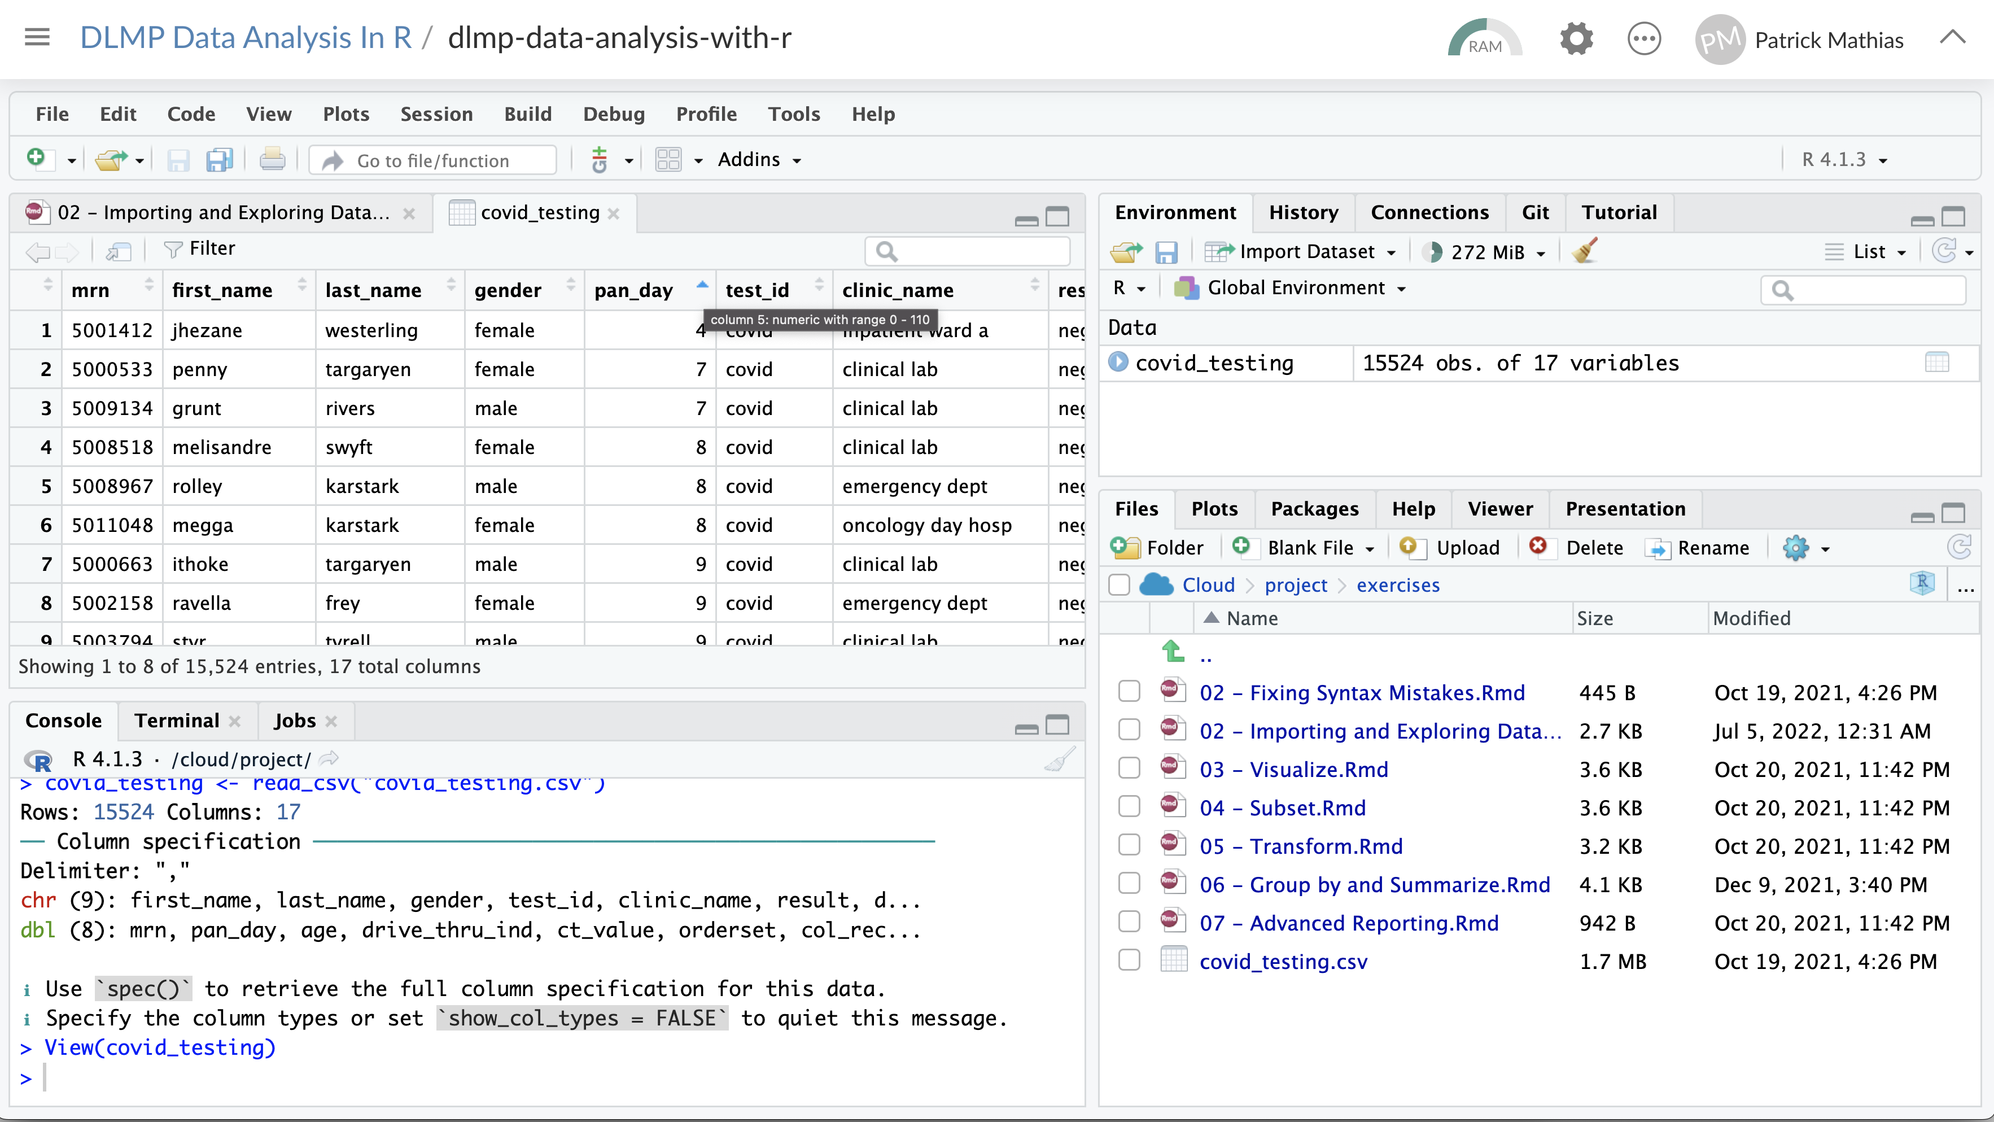
Can sort by clicking on variable
Click on object in Environment
Can open up viewer from console

Slide 30
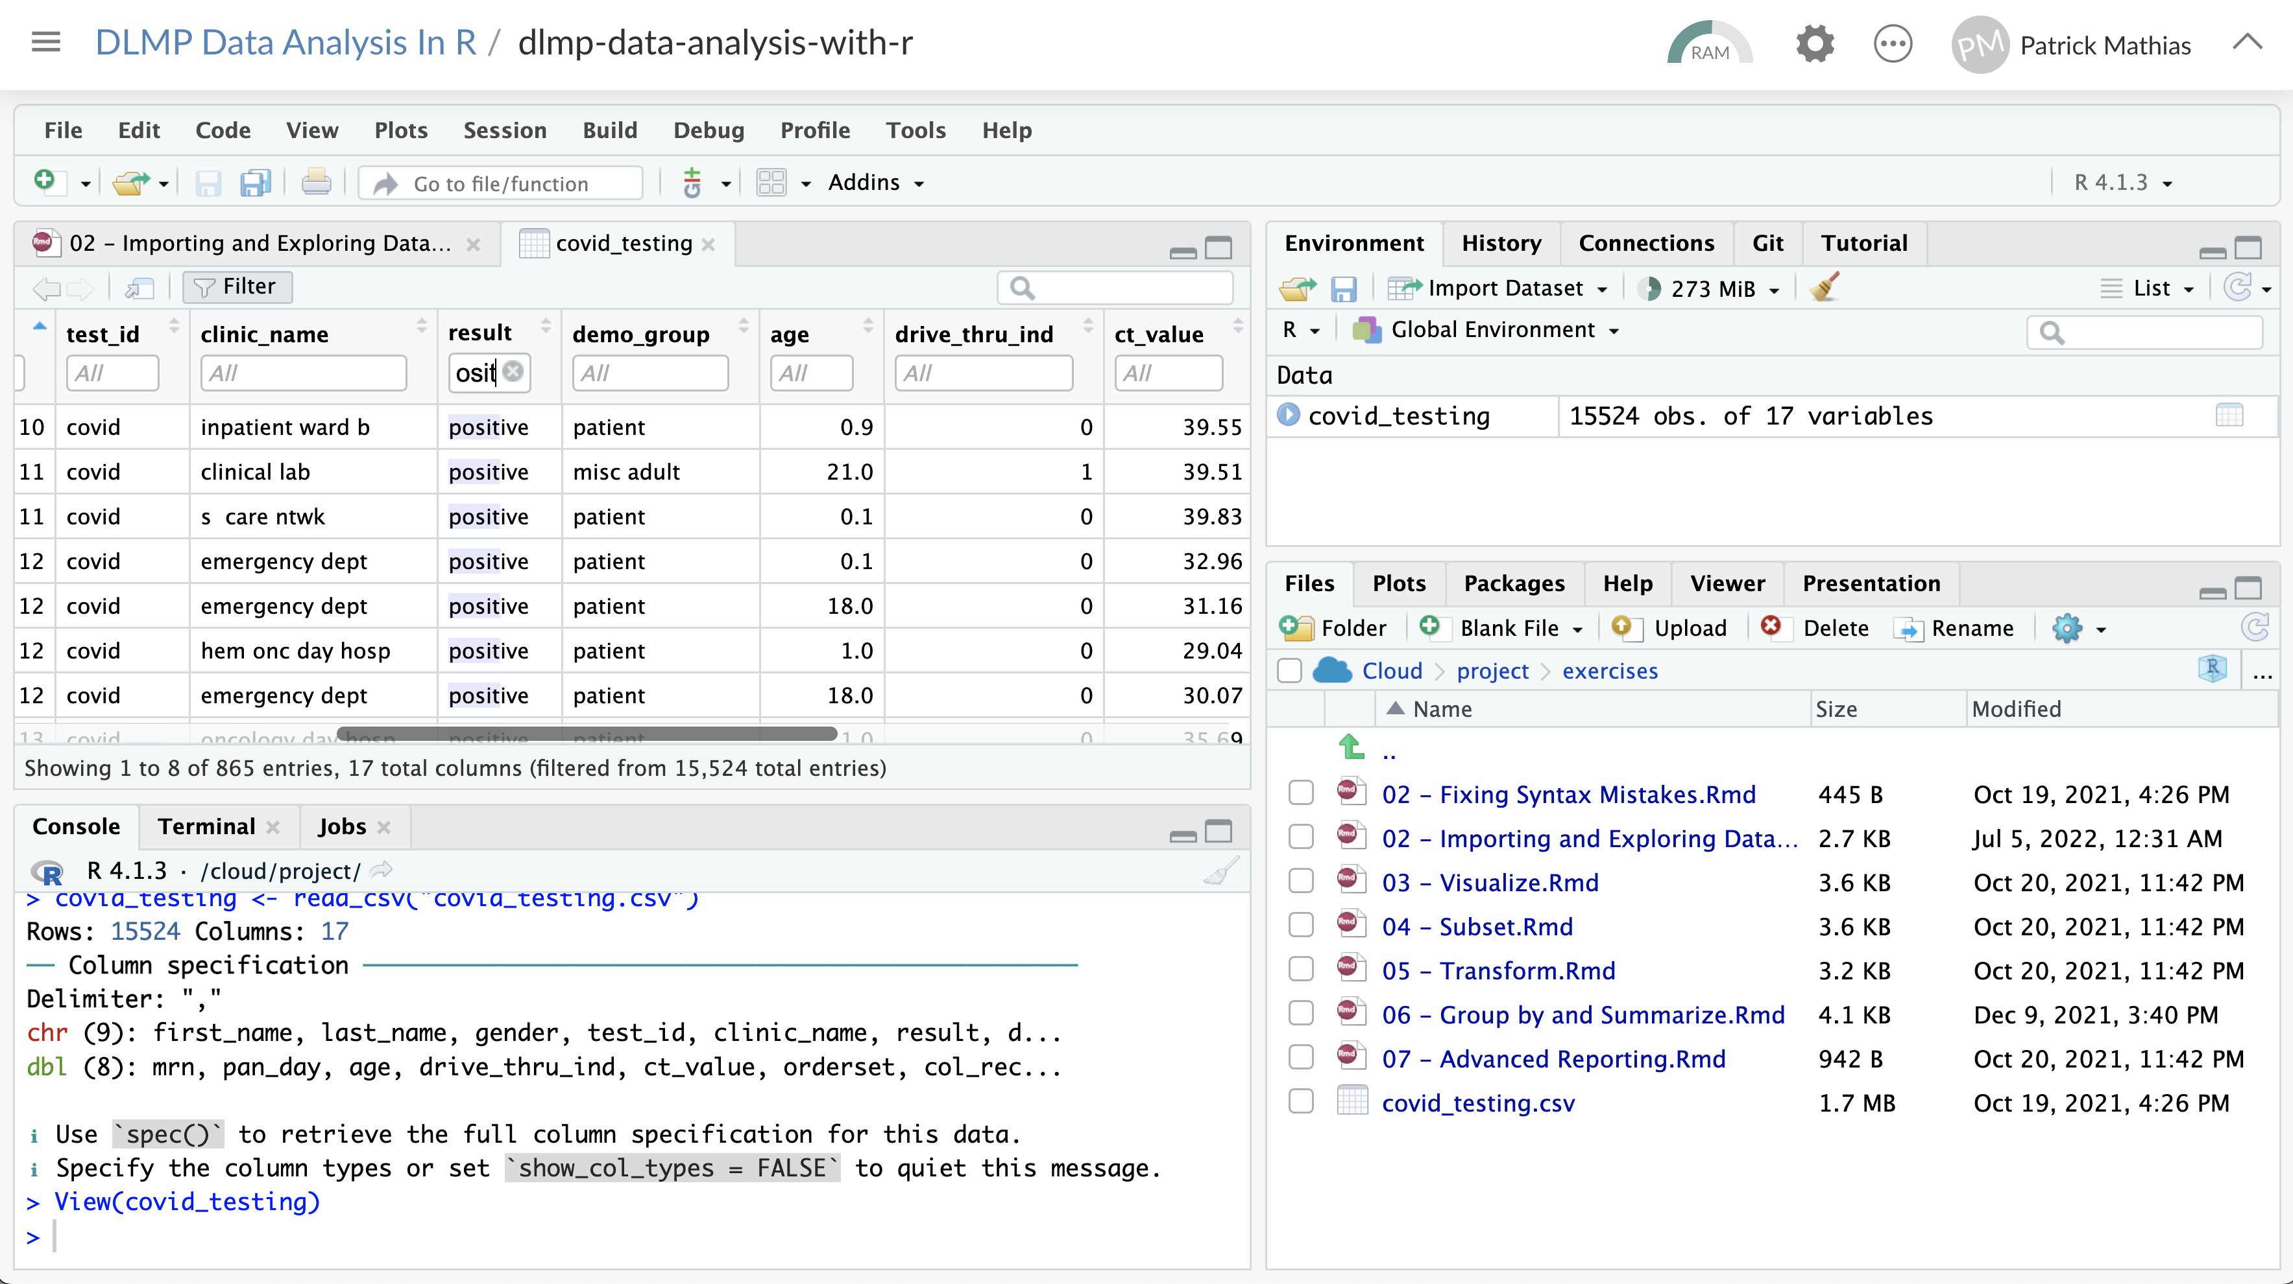
Filter can search variables
Shows rows meeting criteria

Slide 31
Recap
Functions do stuff. They accept Arguments to define parameters. We can store the output of functions in Objects using the assignment operator ( <- ).
Packages extend the functionality of R. They need to be installed once per computer and loaded each session.
Importing Data is the first step data analysis pipeline. read_csv() is a function from the tidyverse that we can use for importing data.
Notes:
To recap what we have covered in this introductory lesson.
We started by defining and differentiating R (the programming language) from Rstudio (the development environment) from R Markdown (the document format we use for reproducible data analysis).
In addition to learning to create and edit R Markdown documents we discussed some basic coding vocabulary including:
-Packages (such as the Tidyverse) which extend the functionality of R. We us the install.packages() function to install packages, and the library() function to load them into the environment.
-Functions do stuff on our behalf, they accept arguments, and we can store their output in named objects using the assignment operator
-Finally we discussed and practiced importing data using the read_csv() function from the tidyverse, and explored this data visually

Slide 32
What else?
Notes:
At the end of each lesson we have included a what else section to introduce you to ”what else” you may want to explore and learn about after completing this course.
This includes helpful hints, other functions in the Tidyverse, and exciting packages you may want to check out.

Slide 33
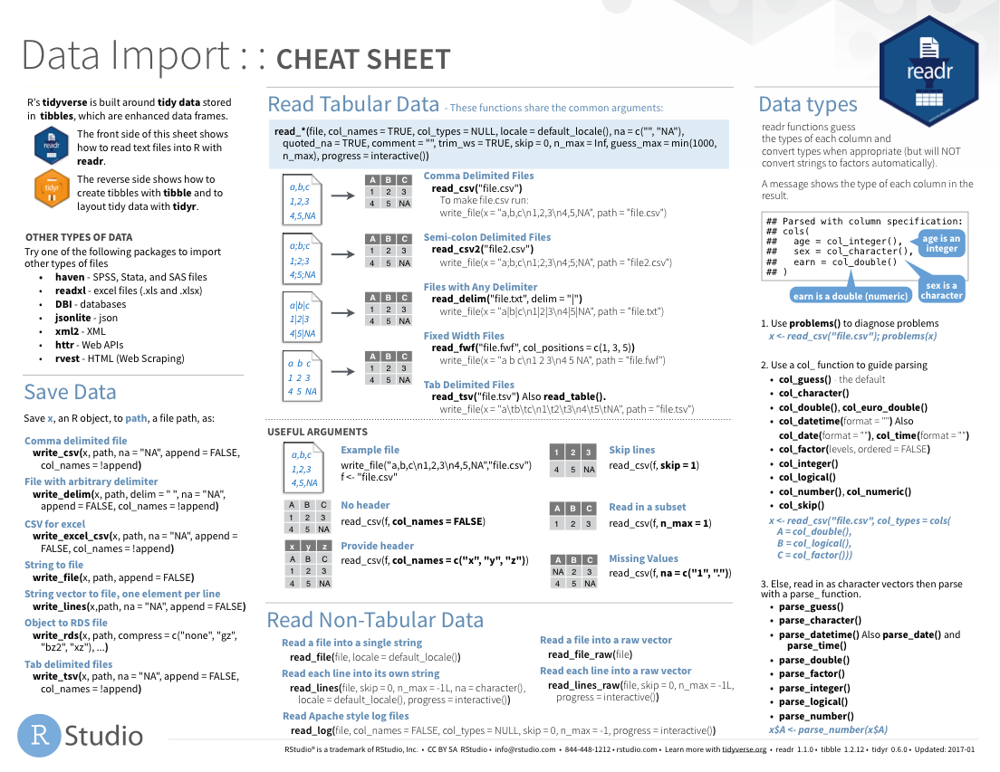
Notes:
The Data Import cheat sheet helps with the grammar of importing data including other file types and those with other separators (like pipes “|” instead of commas).
The Data Import cheat sheet is available on the RStudio website.

Slide 34
Write data to files
name of
CSV file to write to
data frame to write file from
write_csv(data_frame, “file_name.csv”)
data_frame
file_name.csv
csv
Notes:
Let’s put these pieces together to load our covid data set.
This line of code reads the “covid_testing object gets the output of the read_csv function on the covid_testing CSV file”.
You might notice that one of the objects is put in quotes and the other one isn't.
To be honest, quotes can be confusing. Names of objects such as data frames don't get quotes. In contrast, literal file names are always put in quotes. This is part of the grammar of coding (the syntax) in R that will become more familiar to you as you develop proficiency and comfort with the language.

Slide 35
Notes:
There are a variety of other packages out there designed to deal with different file formats:
Readxl: Excel
Haven: SPSS, Stat, SAS files
Googlesheets
Rvest: scrape the web
Jsonlite: JSON data and APIs on the web

Slide 36
Reading Excel files
Load package
library(readxl)
data frame to read data into
name of
CSV file
data_frame <- read_excel(”file_name.xlsx")
data_frame
file_name.xlsx
xlsx
Notes:
Let’s put these pieces together to load our covid data set.
This line of code reads the “covid_testing object gets the output of the read_csv function on the covid_testing CSV file”.
You might notice that one of the objects is put in quotes and the other one isn't.
To be honest, quotes can be confusing. Names of objects such as data frames don't get quotes. In contrast, literal file names are always put in quotes. This is part of the grammar of coding (the syntax) in R that will become more familiar to you as you develop proficiency and comfort with the language.

Slide 37
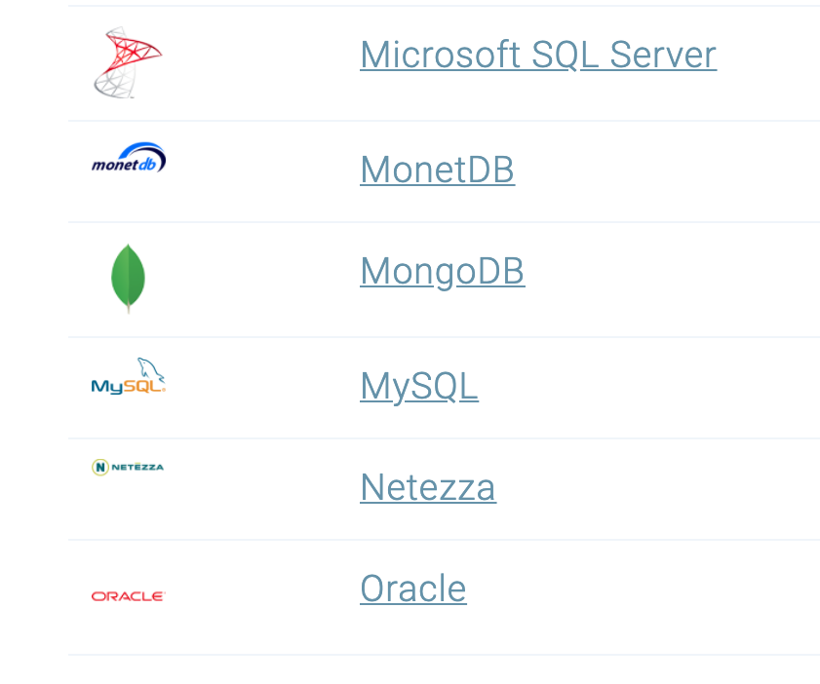
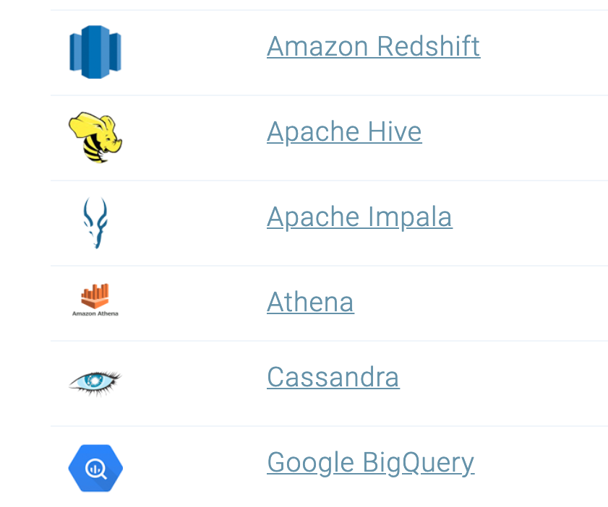
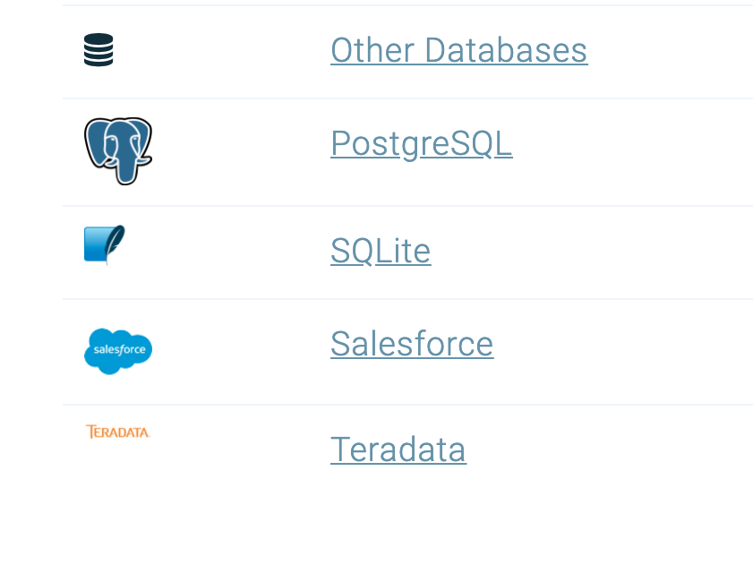
Databases
https://db.rstudio.com/databases/
Notes:
You can also connect to a variety of different databases directly in R to source your data.
If you use any of these, you may want to check out the tools to make database connections in R.

Slide 38
R Interface to Python
library(reticulate)
```{python}
import pandas
covid_testing.info()
```
Notes:
The reticulate package provides an interface between R and python.
This means, you can mix code chunks written in R with code chunks written in Python.
R does many things really well, but no programming language is perfect for all tasks. It is great that R gives us tools to mix and match languages in different code chunks in situ.
For those of you new to coding, we recommend focusing on a single language to develop proficiency before moving on to another language. This will shorten the learning curve for your first and future languages.

Slide 39
Lesson Goals
Learn some fundamental of coding
Lesson Objectives
Define and use functions
Define and create objects in the environment
Install and load packages
Import data into R
Interact with a dataframe
Notes:
In the second session we will learn some fundamentals of coding including using functions, creating objects, and importing data.

